Slide 1
Regional Anomalies Data set v.1.2 vs SWM and CRU (precip)

Slide 2
Livneh v.1.2
SWM
DJF
CRU
Precipitation

Slide 3
Livneh v.1.2
SWM
JJA
CRU
Precipitation

Slide 4
Livneh v.1.2
SWM
MAM
CRU
Precipitation

Slide 5
Livneh v.1.2
SWM
SON
CRU
Precipitation

Slide 6
TMAX
Livneh v.1.2
SWM
SON
MAM

Slide 7
TMAX
Livneh v.1.2
SWM
DJF
JJA

Slide 8
TMIN
Livneh v.1.2
SWM
SON
MAM

Slide 9
TMIN
Livneh v.1.2
SWM
DJF
JJA

Slide 10
Differences between stations and nearest grid cell
Only considered stations with at least 20 years of data
Assumption is that these stations were used in the gridding process
Without running the code for each cell, cannot confirm that these stations were used in the gridding, however, it is highly likely
Results follow fairly well; larger departures in the earlier part of the record when fewer stations available.

Slide 11
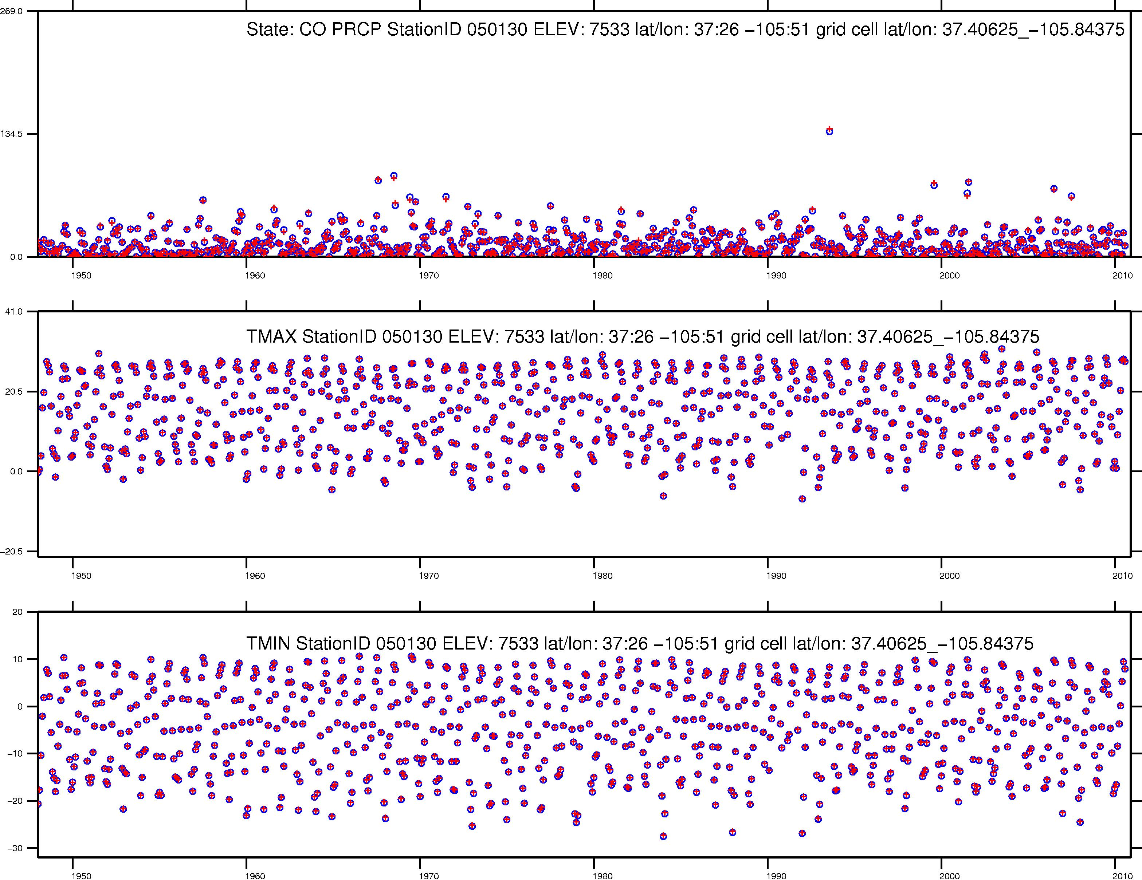
Station value
+
Nearest grid cell value
Monthly Precipitation (mm)
Mean Monthly Temperature (C)
Mean Monthly Temperature (C)

Slide 12
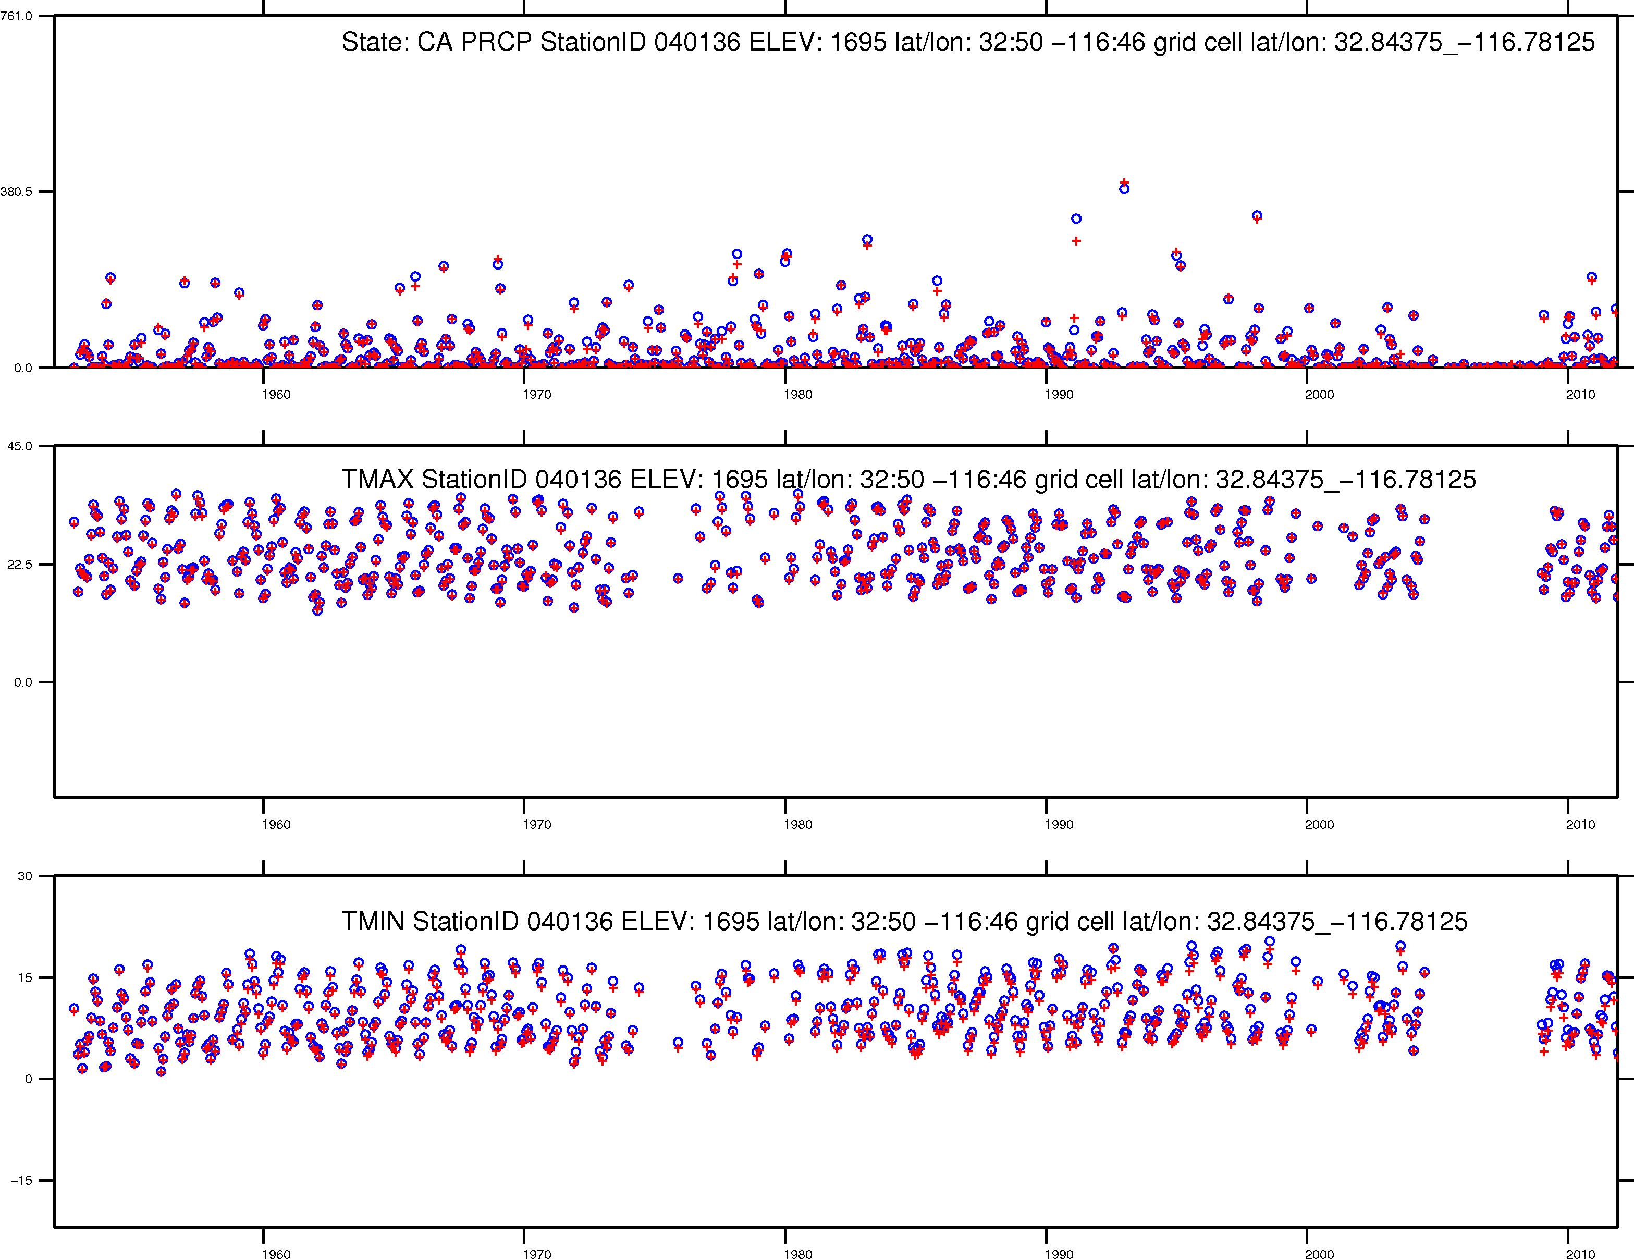
Station value
+
Nearest grid cell value
Monthly Precipitation (mm)
Mean Monthly Temperature (C)
Mean Monthly Temperature (C)

Slide 13
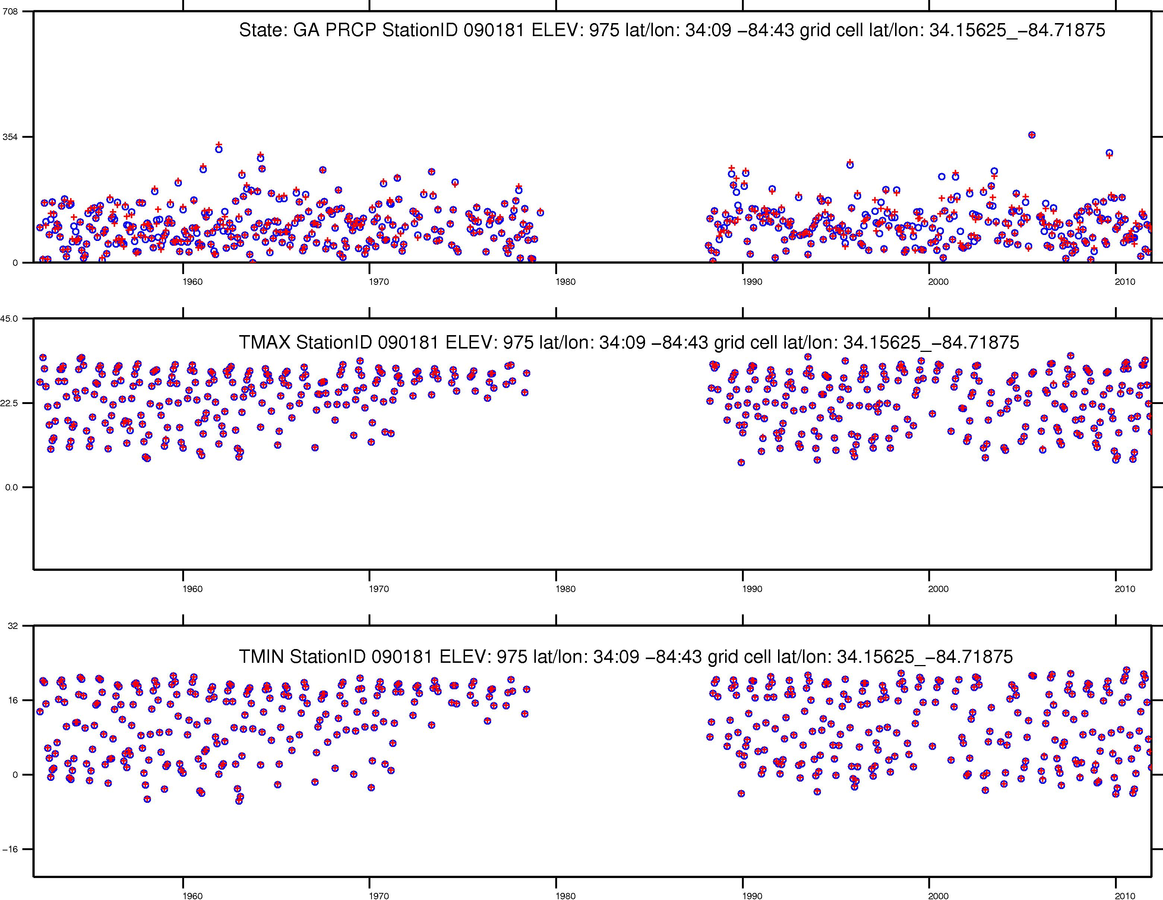
Station value
+
Nearest grid cell value
Monthly Precipitation (mm)
Mean Monthly Temperature (C)
Mean Monthly Temperature (C)

Slide 14
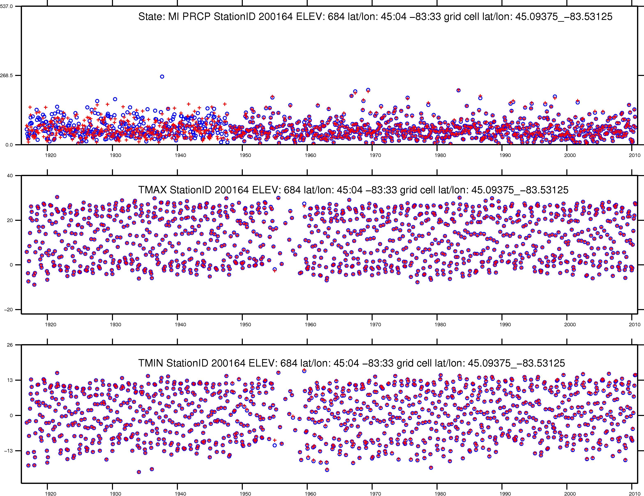
Station value
+
Nearest grid cell value
Monthly Precipitation (mm)
Mean Monthly Temperature (C)
Mean Monthly Temperature (C)

Slide 15
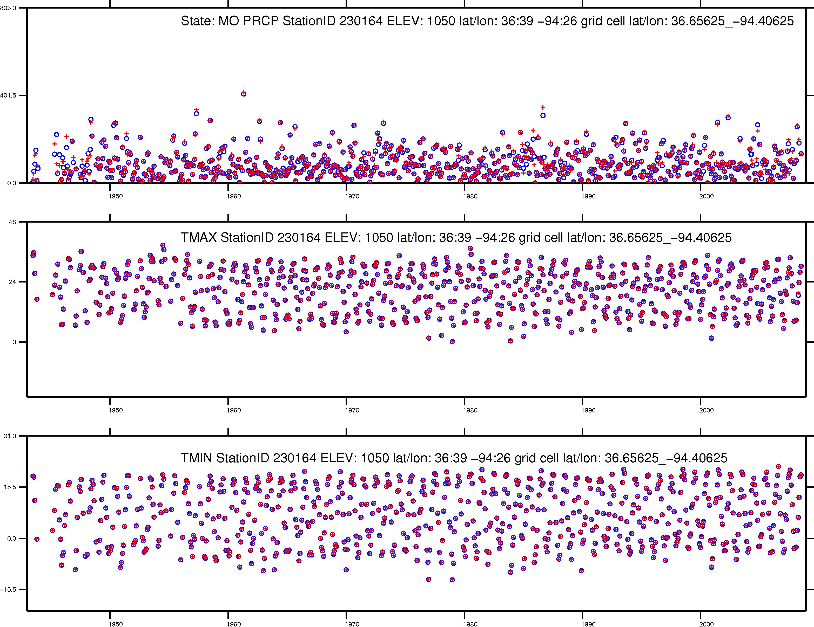
Station value
+
Nearest grid cell value
Monthly Precipitation (mm)
Mean Monthly Temperature (C)
Mean Monthly Temperature (C)

Slide 16
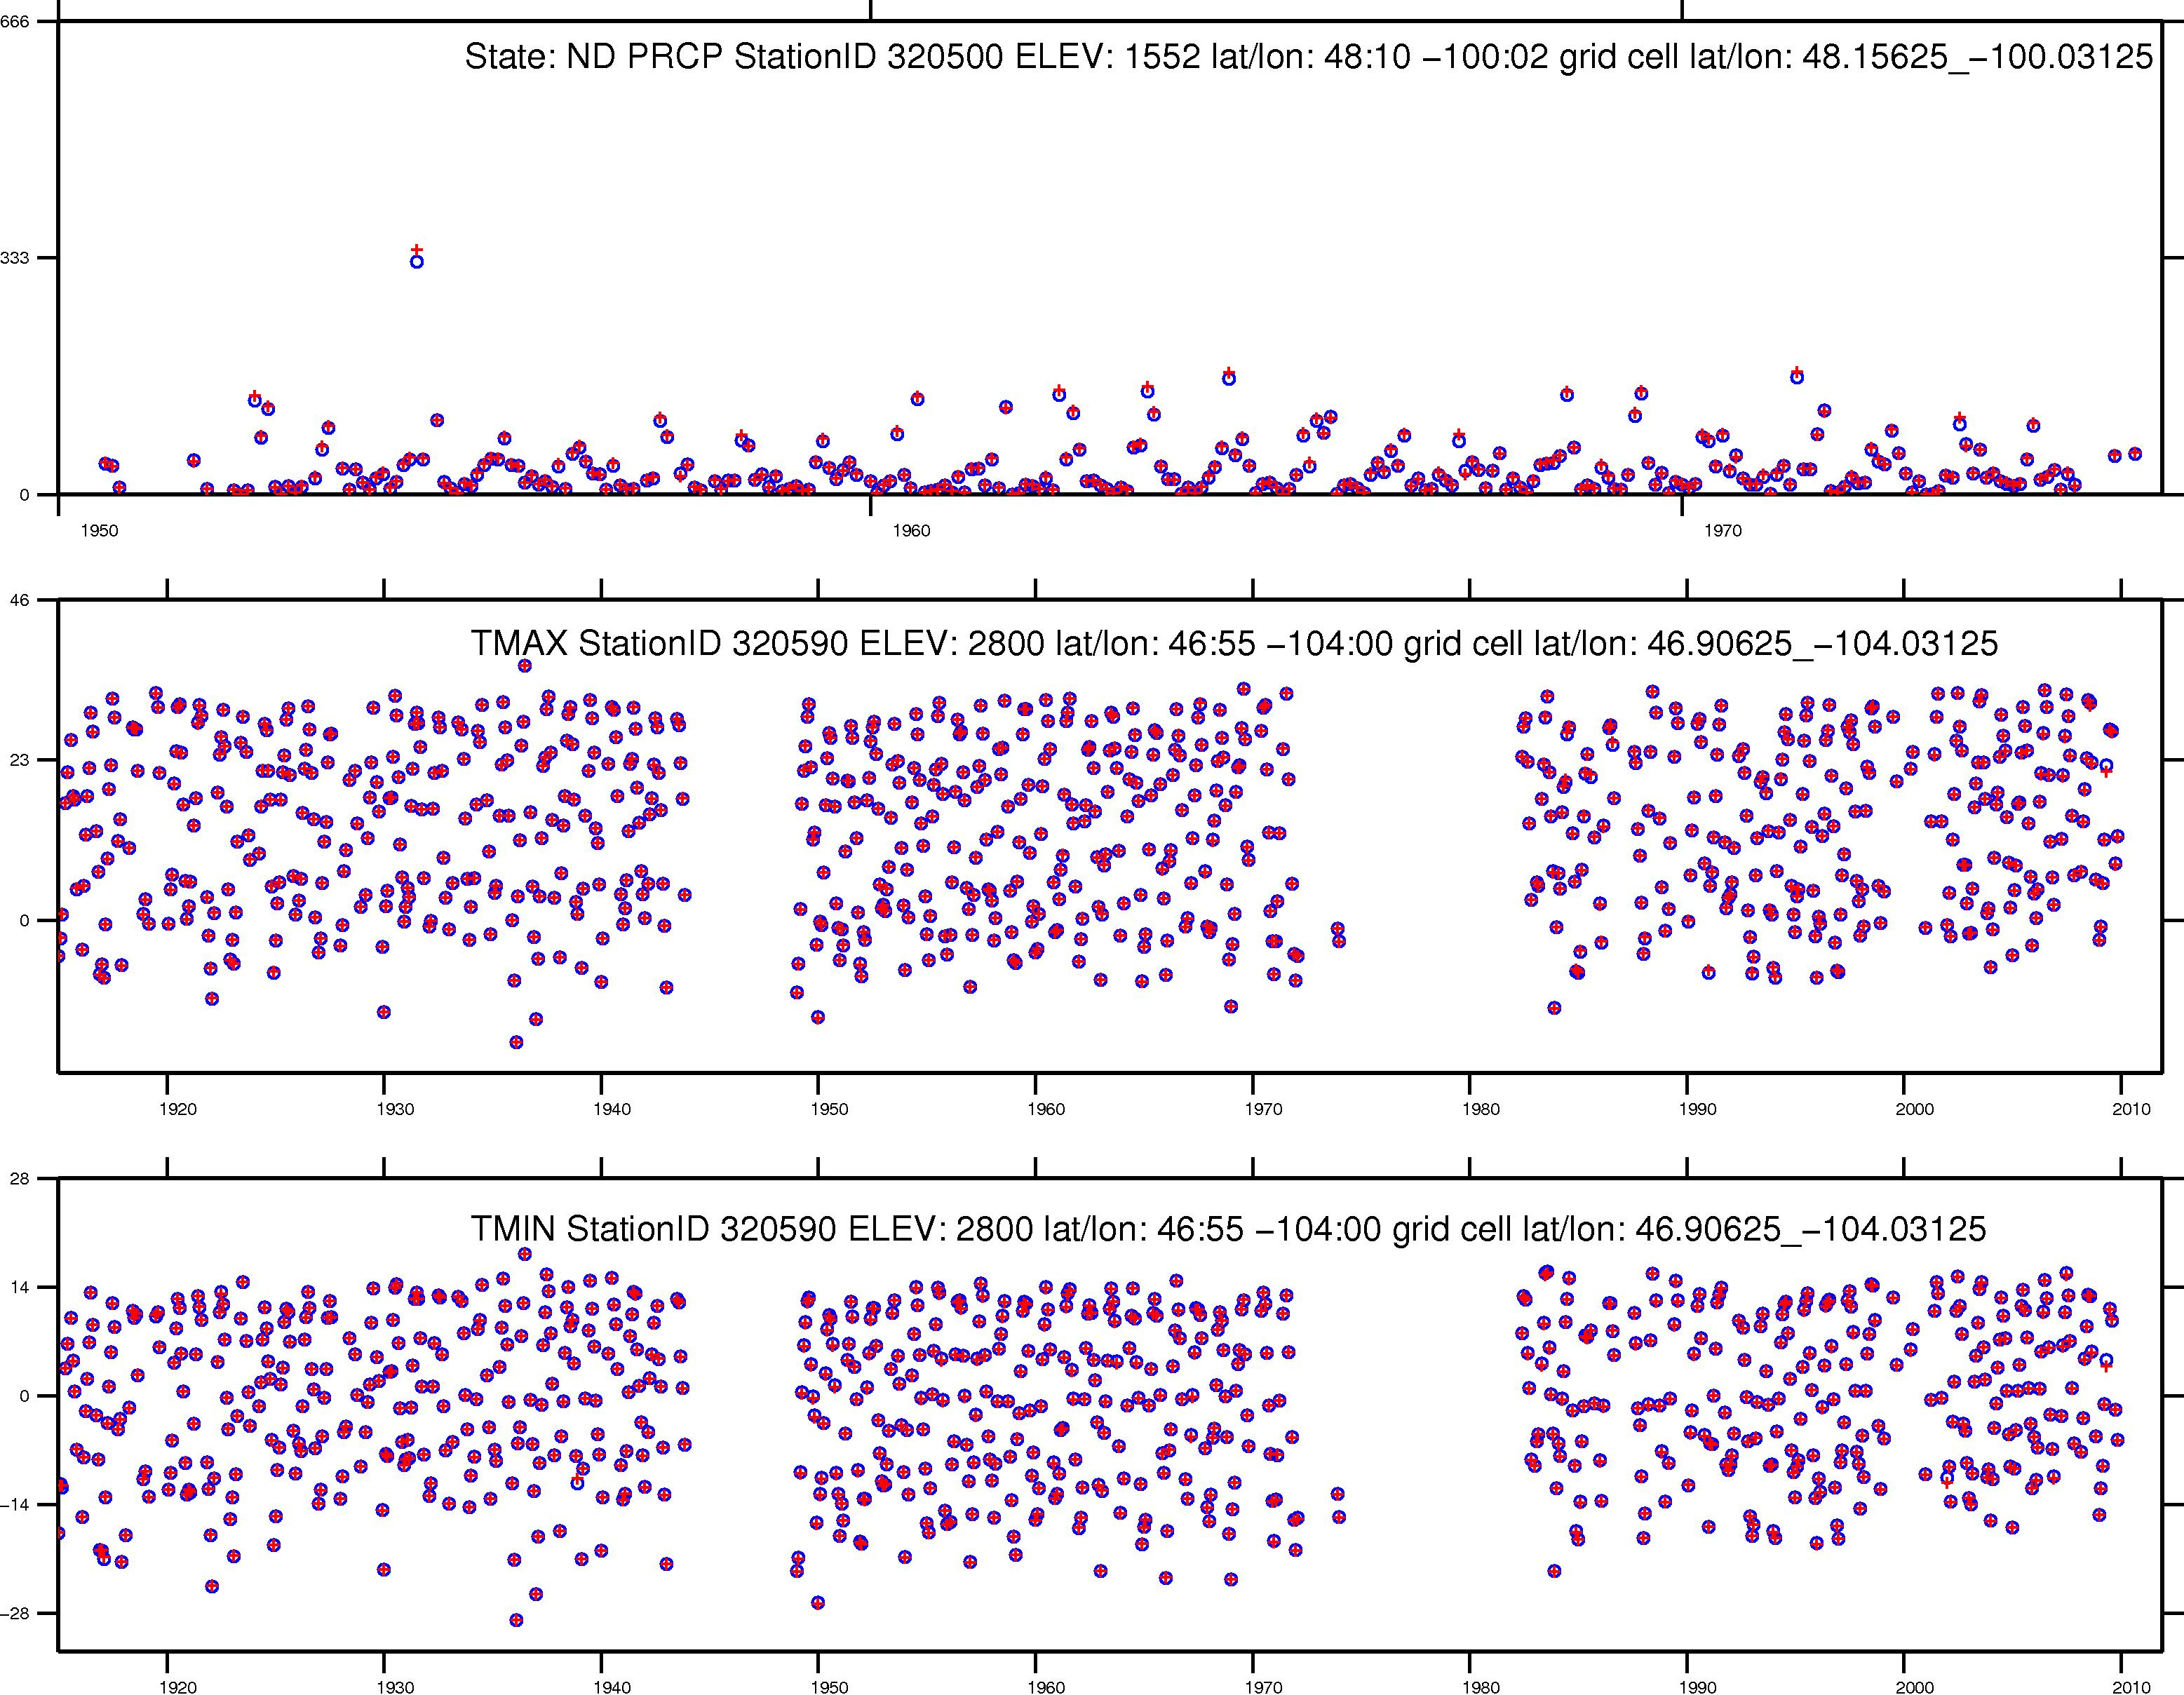
Station value
+
Nearest grid cell value
Monthly Precipitation (mm)
Mean Monthly Temperature (C)
Mean Monthly Temperature (C)

Slide 17
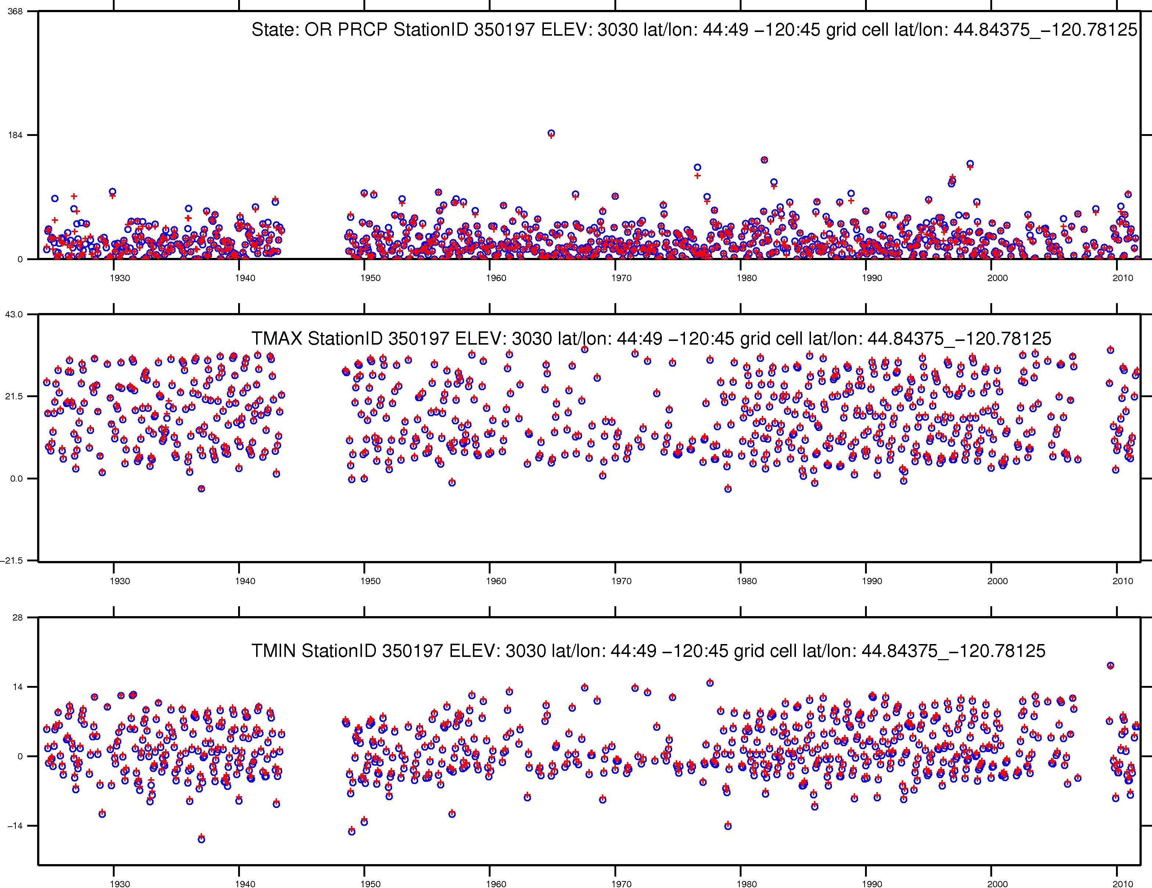
Station value
+
Nearest grid cell value
Monthly Precipitation (mm)
Mean Monthly Temperature (C)
Mean Monthly Temperature (C)

Slide 18
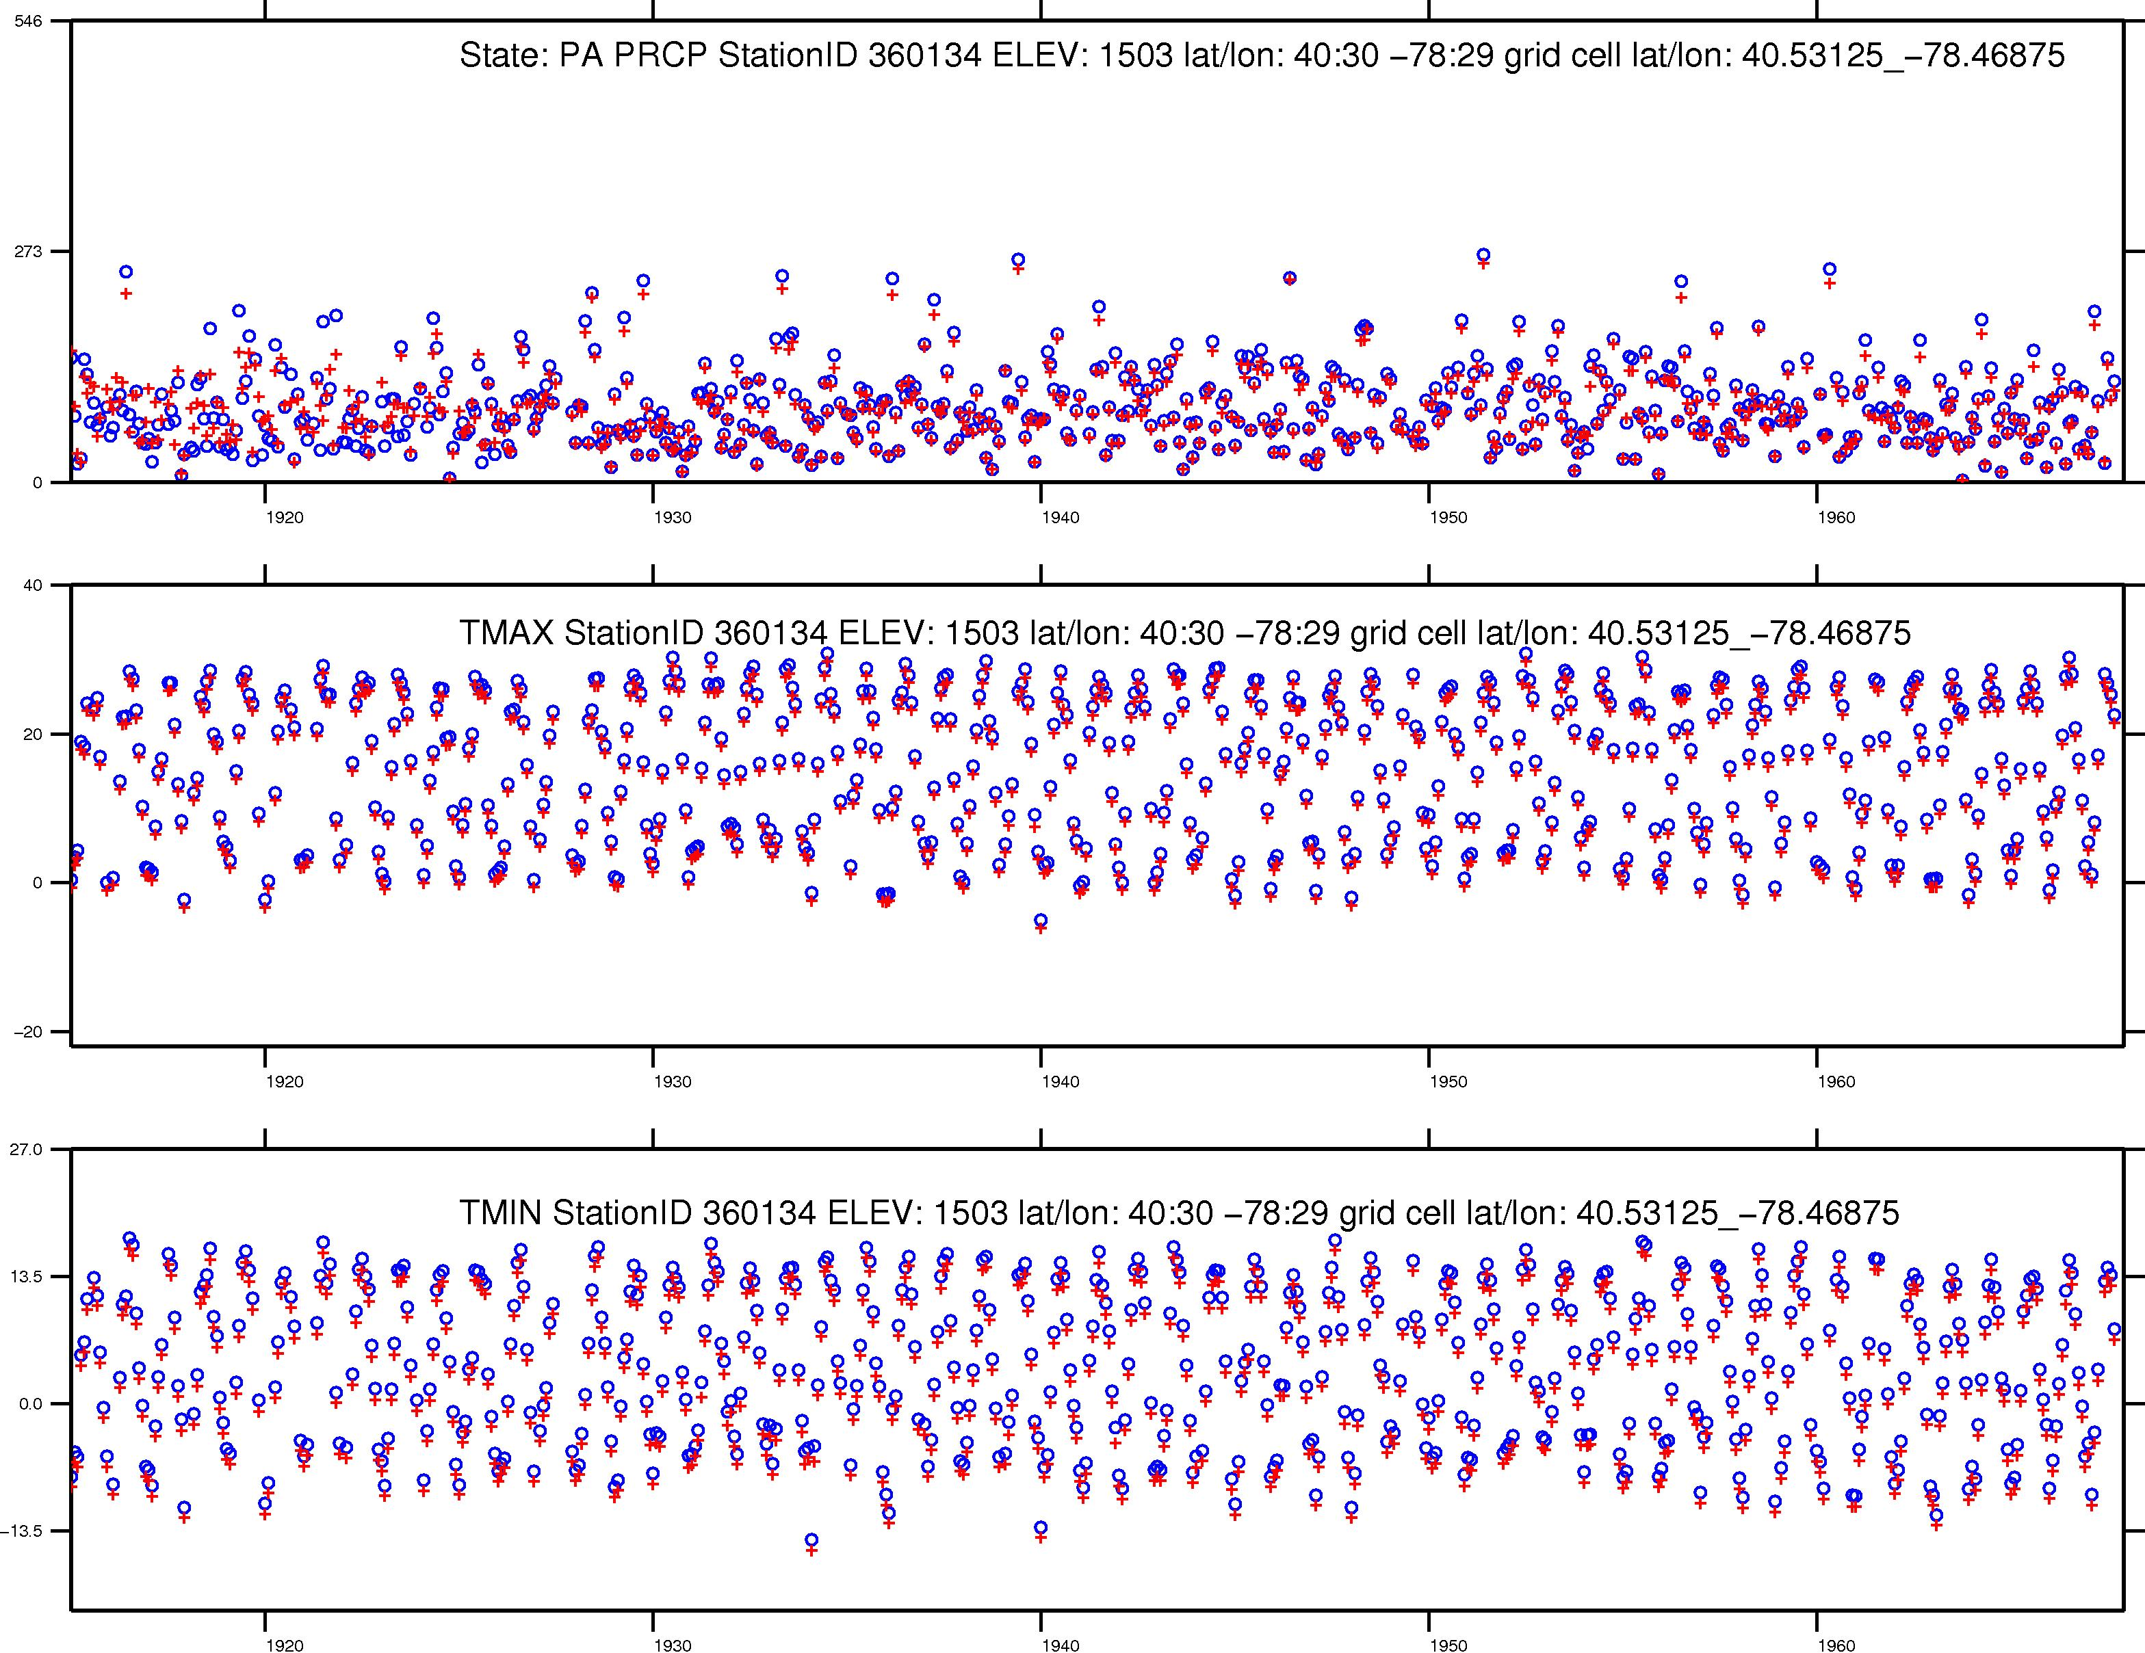
Station value
+
Nearest grid cell value
Monthly Precipitation (mm)
Mean Monthly Temperature (C)
Mean Monthly Temperature (C)

Slide 19
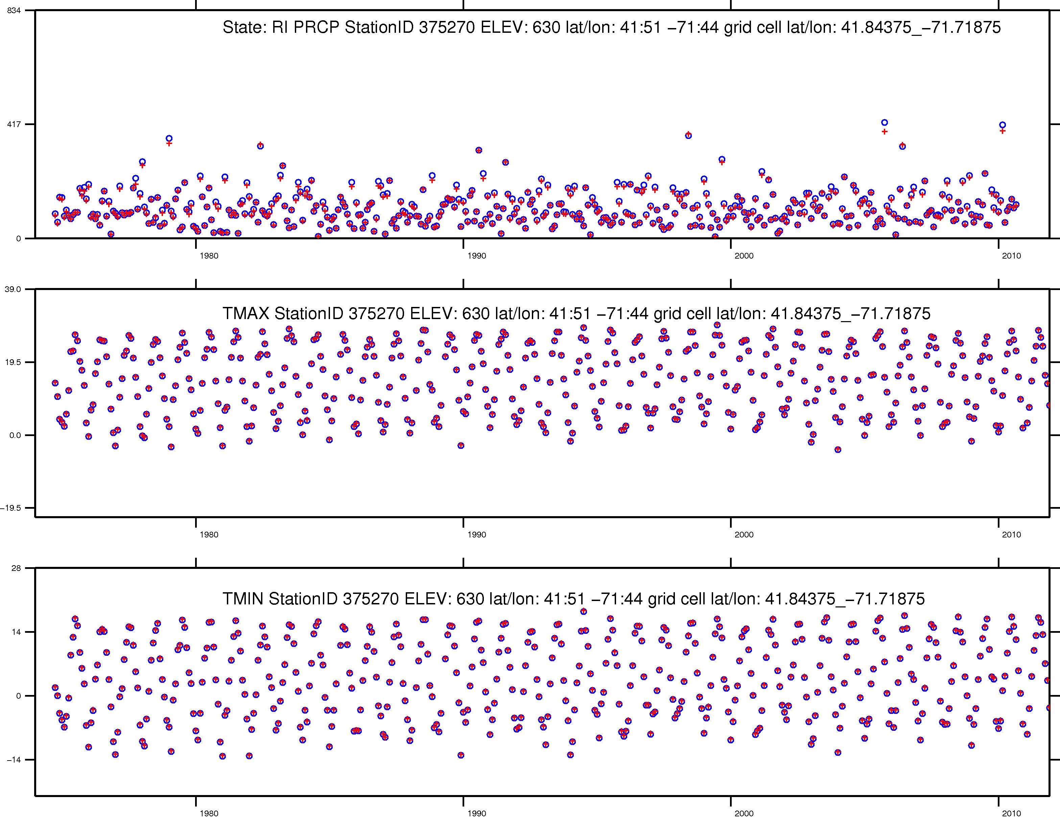
Station value
+
Nearest grid cell value
Monthly Precipitation (mm)
Mean Monthly Temperature (C)
Mean Monthly Temperature (C)

Slide 20
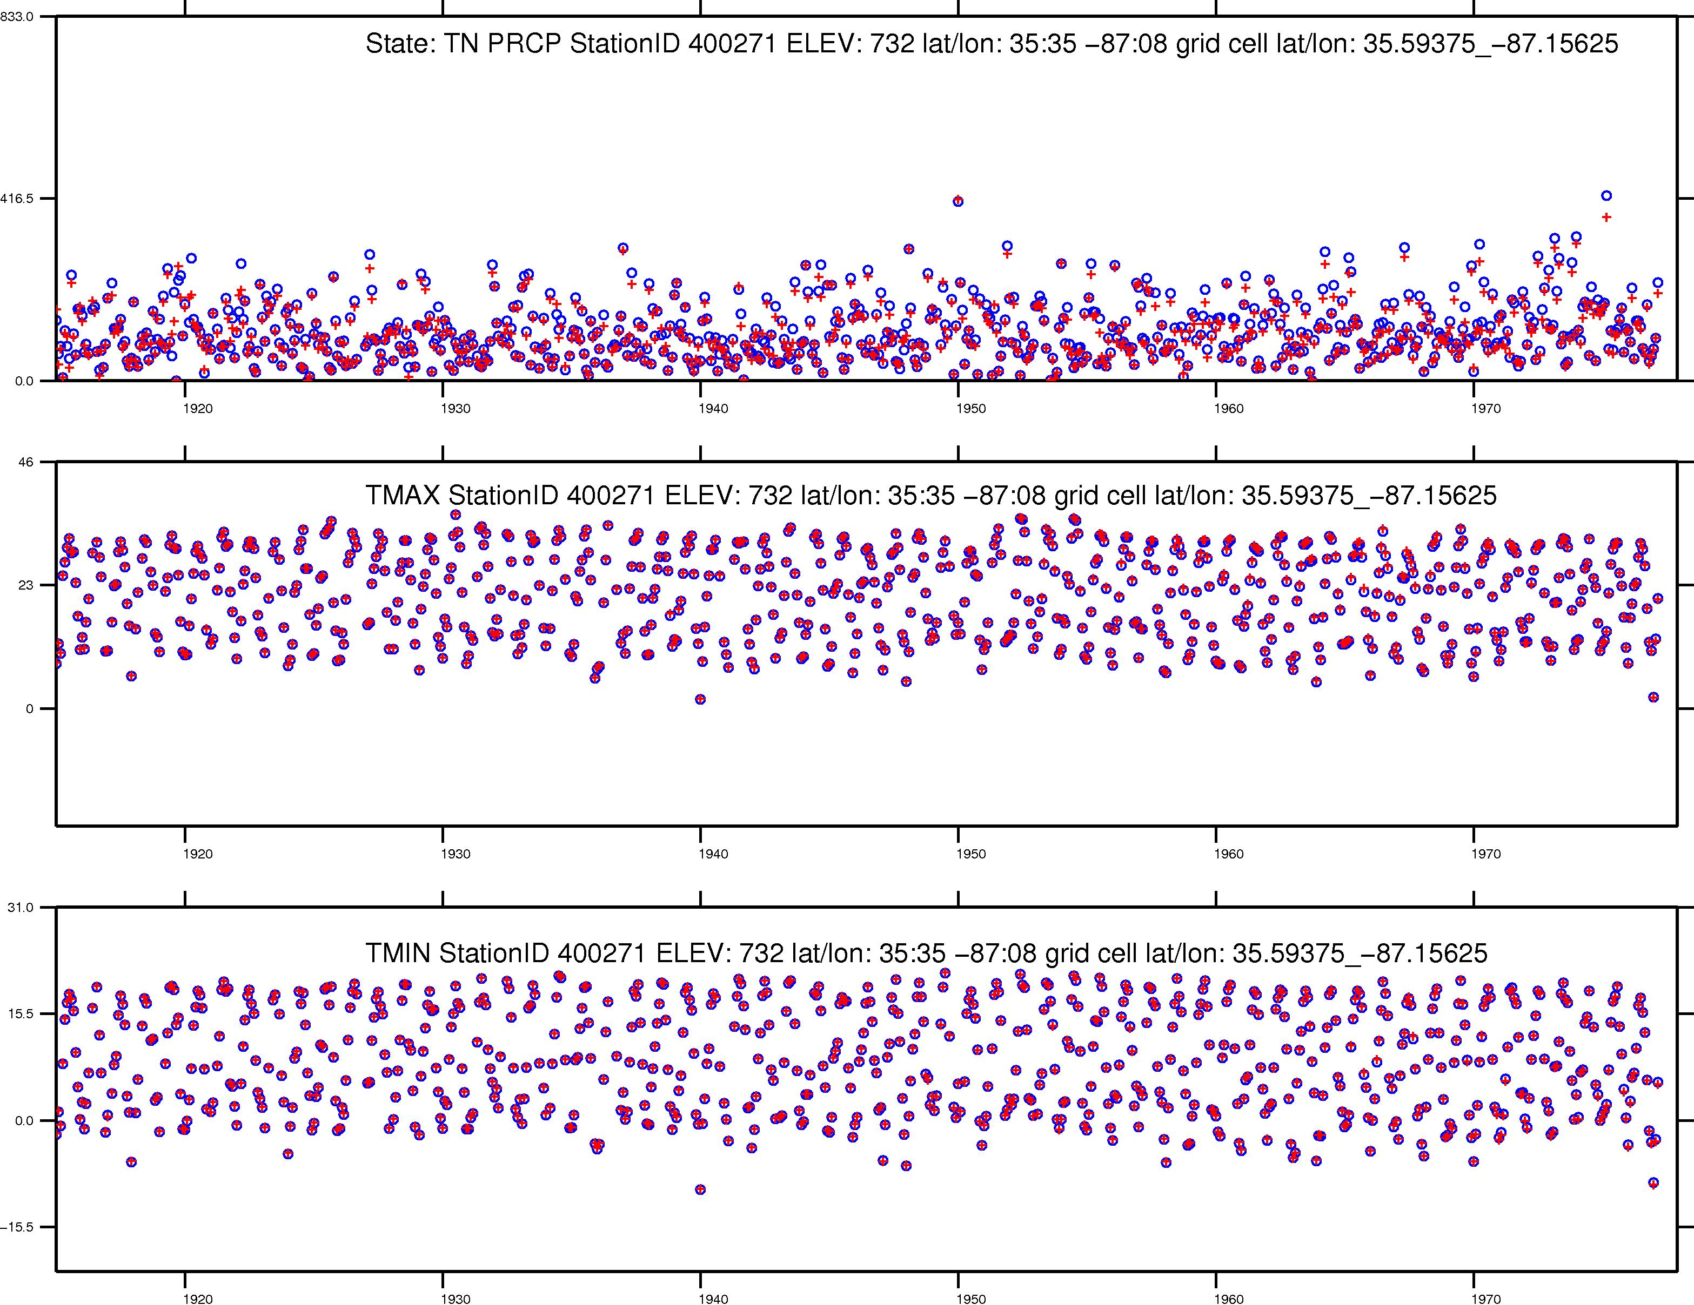
Station value
+
Nearest grid cell value
Monthly Precipitation (mm)
Mean Monthly Temperature (C)
Mean Monthly Temperature (C)

Slide 21
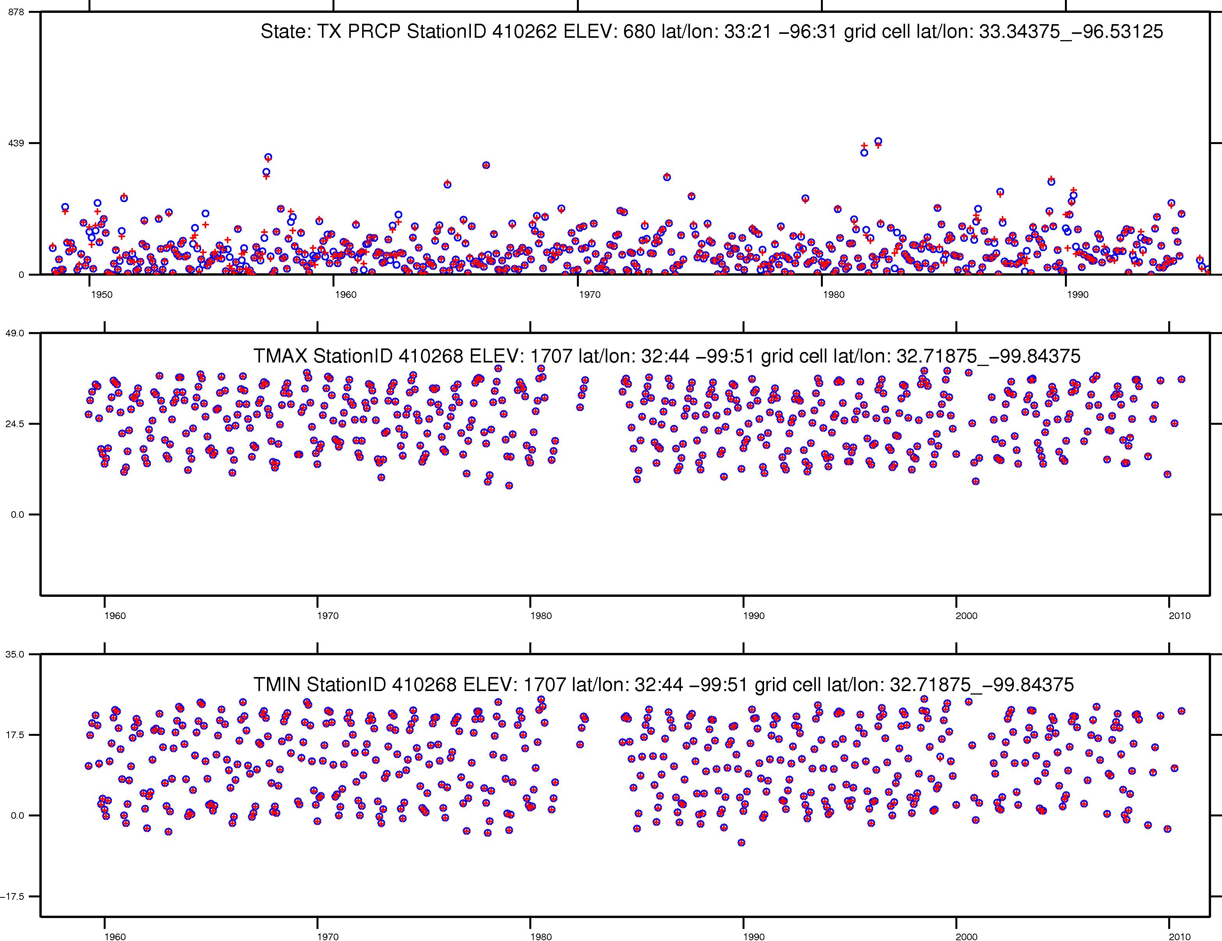
Station value
+
Nearest grid cell value
Monthly Precipitation (mm)
Mean Monthly Temperature (C)
Mean Monthly Temperature (C)

Slide 22
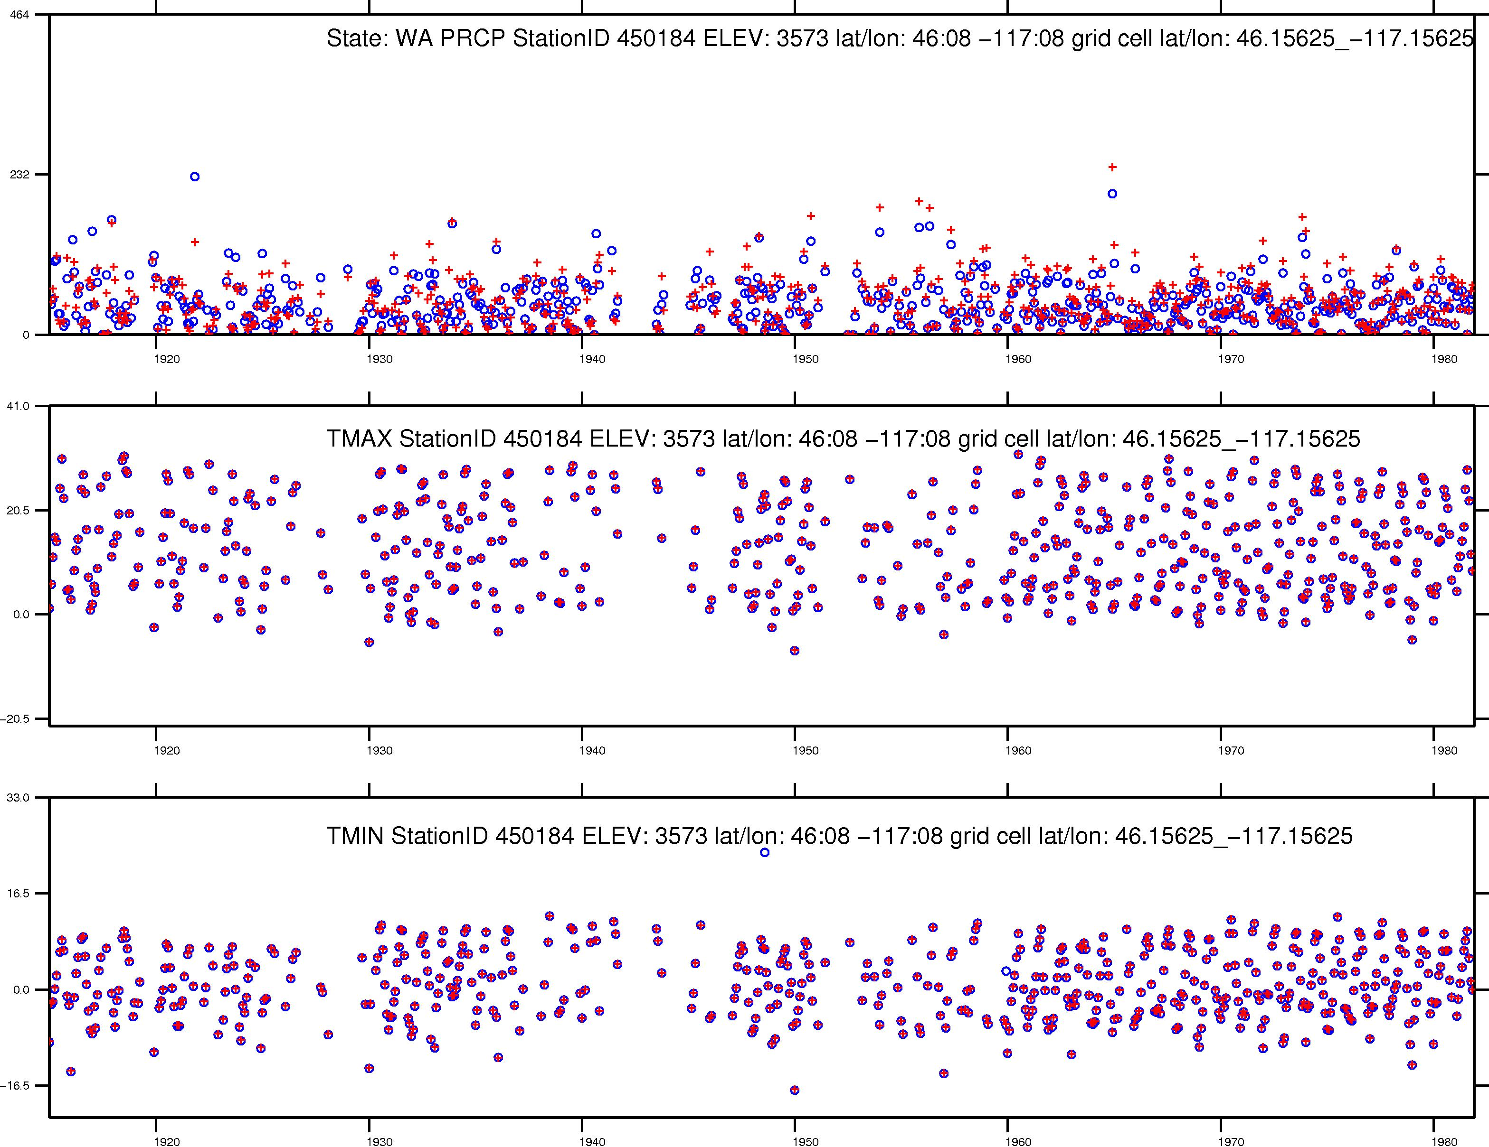
Station value
+
Nearest grid cell value
Monthly Precipitation (mm)
Mean Monthly Temperature (C)
Mean Monthly Temperature (C)

Slide 23
Differences between v.1.2 and v.1.1 and v.1.0
Things generally follow as expected from email exchanges
Precip between v.1.2 and v.1.1 are identical with the exception of an ‘erroneous’ precipitation panel
Temperatures between v.1.2 and v.1.1 are mainly different b/c of the erroneous HCN 0 deg. F cutoff; also minor differences – see second part of # 3 below
Temperatures between v.1.2 and v.1.0 are generally in agreement with the exceptions:
Canada (lat/lon issues corrected)
CA, TX (repeated station entries)
Elsewhere, minor differences (removal of both TMAX<=TMIN station entries; and any days where either TMAX, or TMIN = nodata)

Slide 24
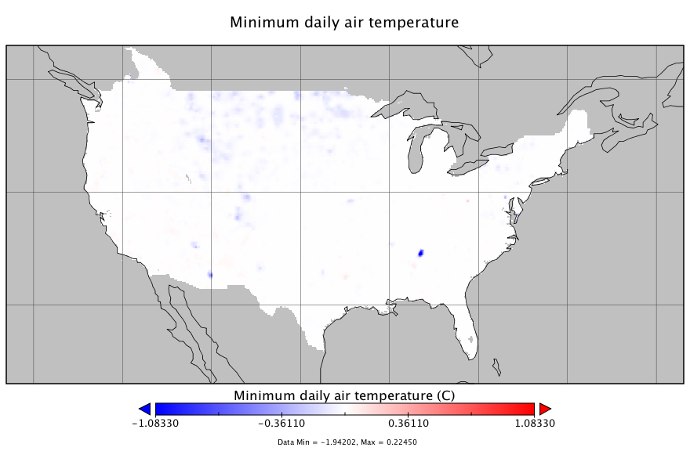
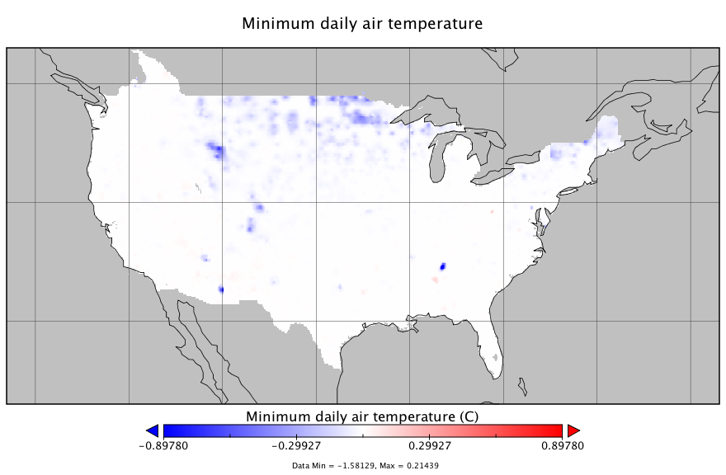
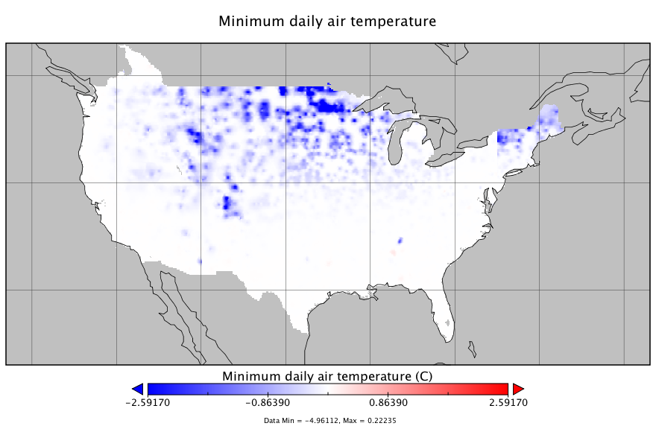
TMIN difference between v.1.2 and v.1.1 (i.e. v.1.2 minus v.1.1)
SON
MAM
DJF
JJA

Slide 25
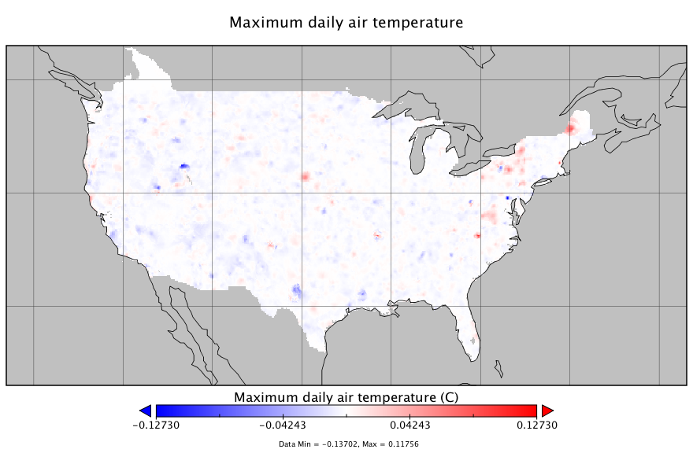
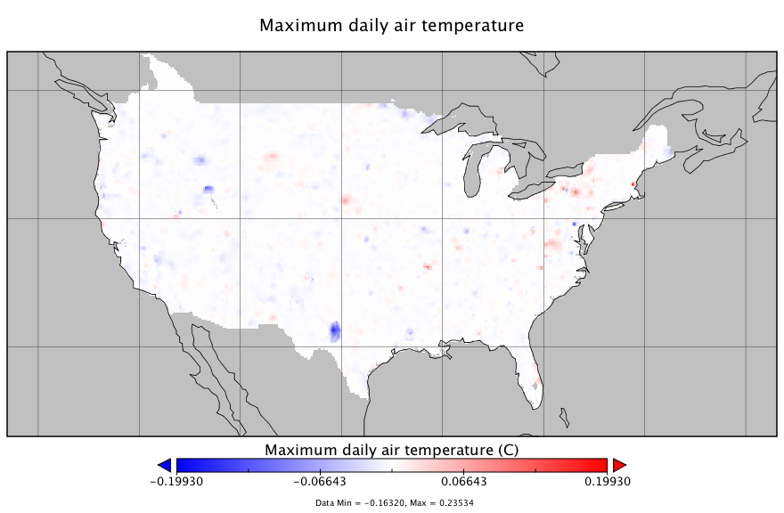
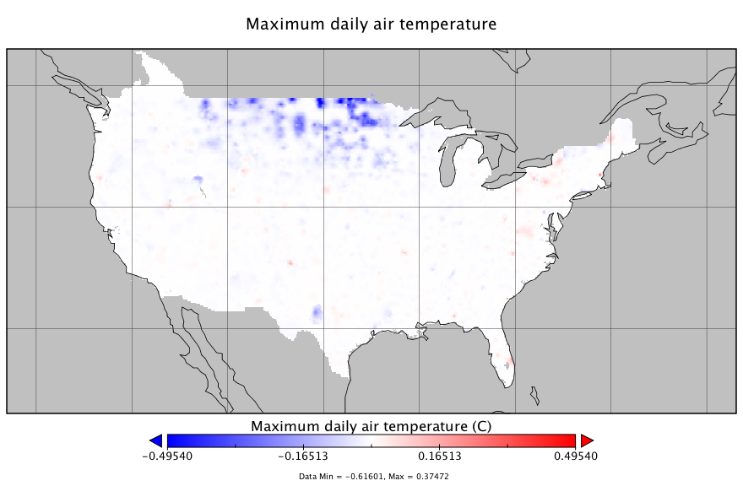
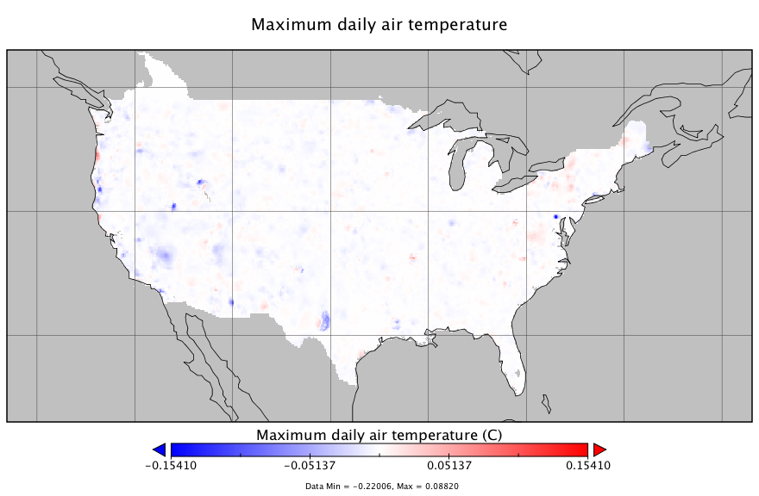
TMAX difference between v.1.2 and v.1.1 (i.e. v.1.2 minus v.1.1)
SON
MAM
DJF
JJA

Slide 26
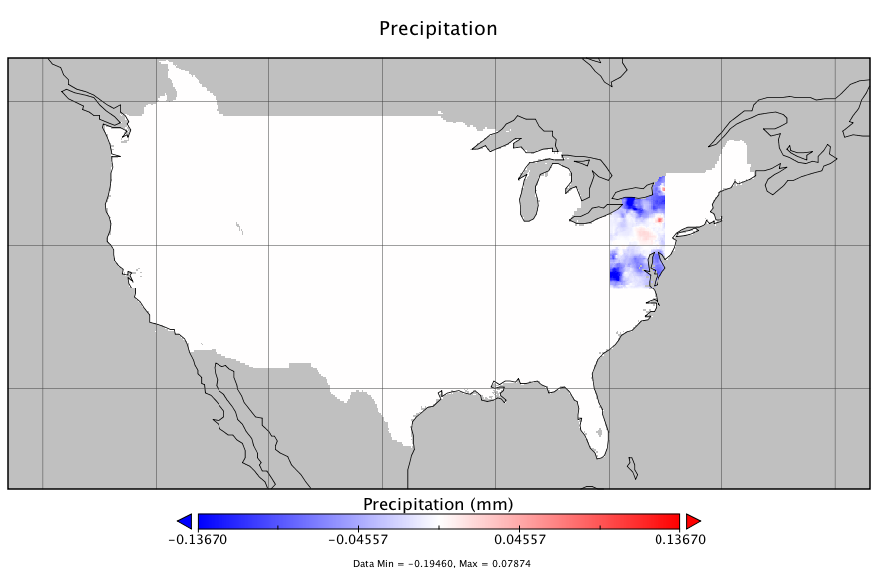
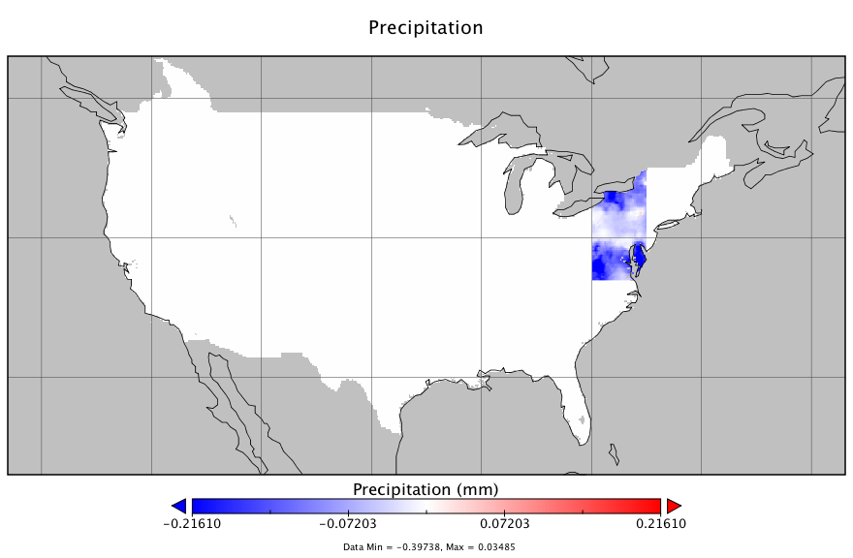
PRCP difference between v.1.2 and v.1.1 (i.e. v.1.2 minus v.1.1)
SON
MAM
DJF
JJA

Slide 27
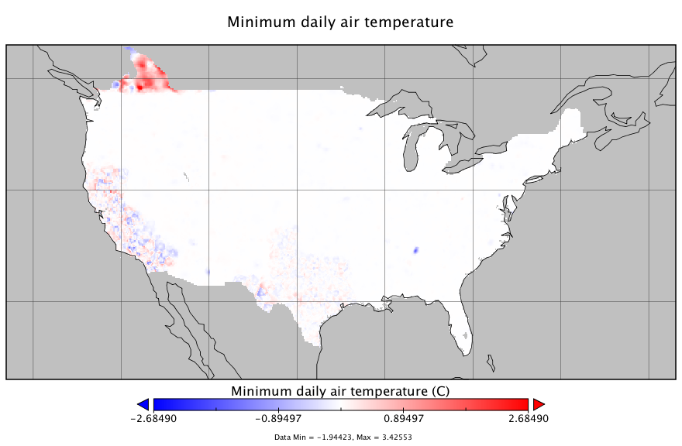
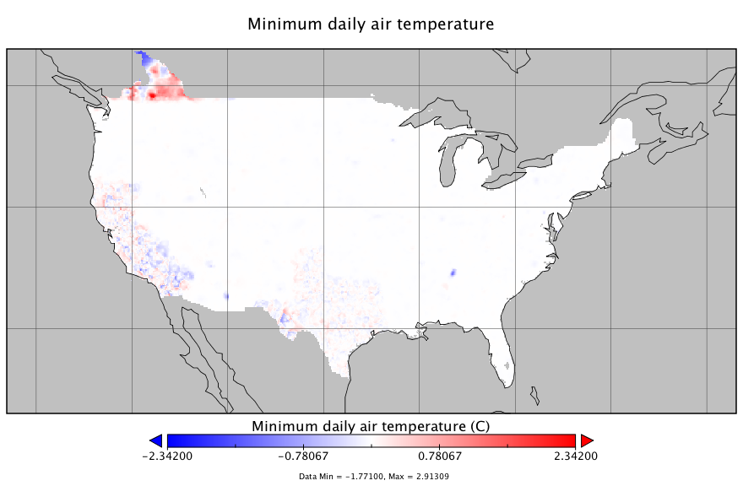
TMIN difference between v.1.2 and v.1.0 (i.e. v.1.2 minus v.1.0)
SON
MAM
DJF
JJA

Slide 28
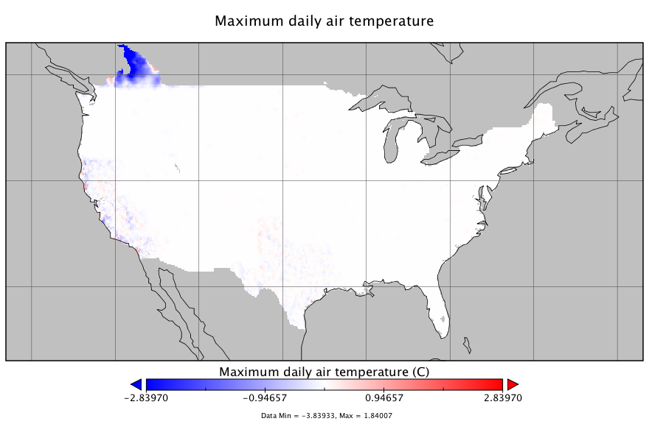
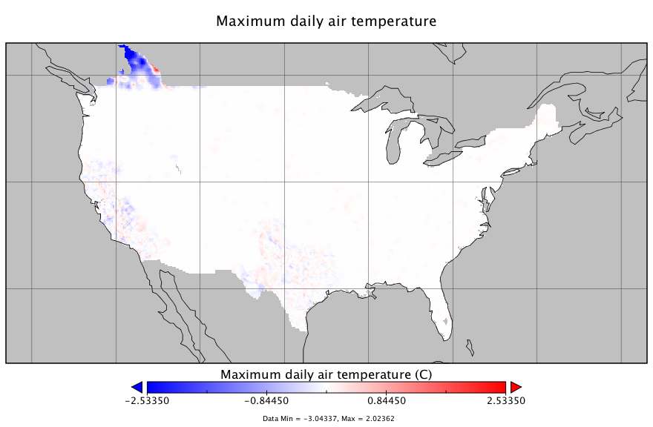
TMAX difference between v.1.2 and v.1.0 (i.e. v.1.2 minus v.1.0)
SON
MAM
DJF
JJA

Slide 29
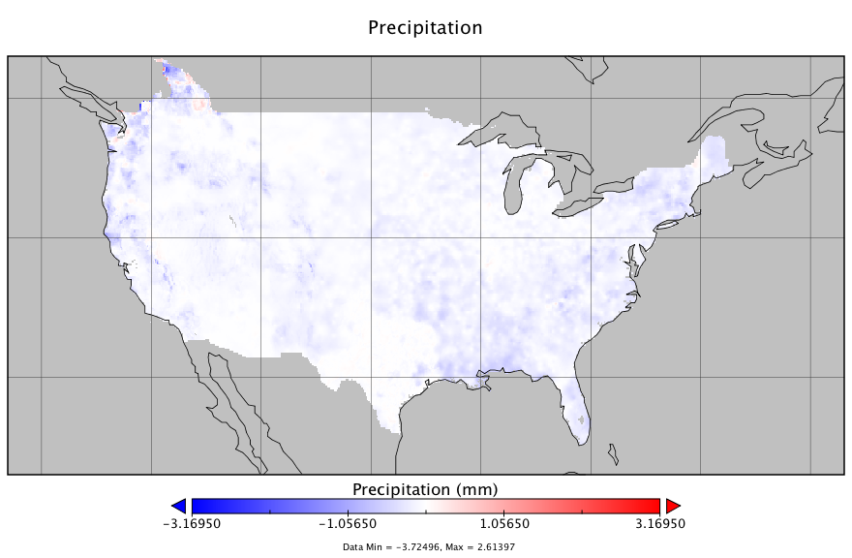
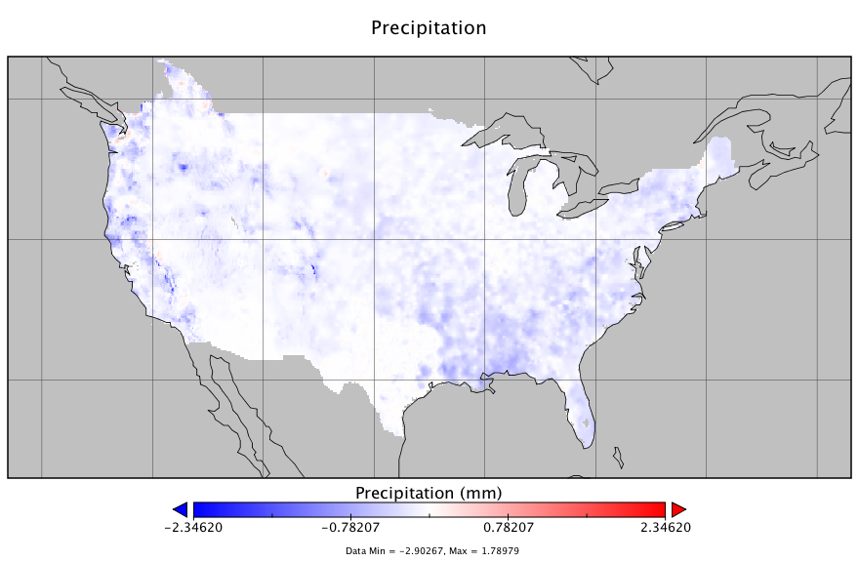
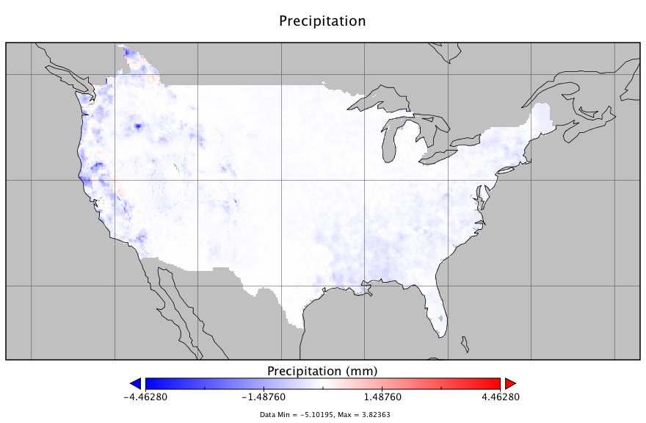
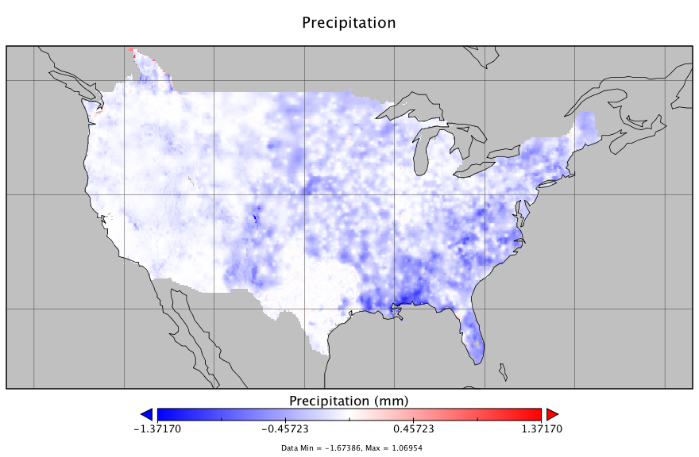
PRCP difference between v.1.2 and v.1.0 (i.e. v.1.2 minus v.1.0)
SON
MAM
DJF
JJA

Slide 30
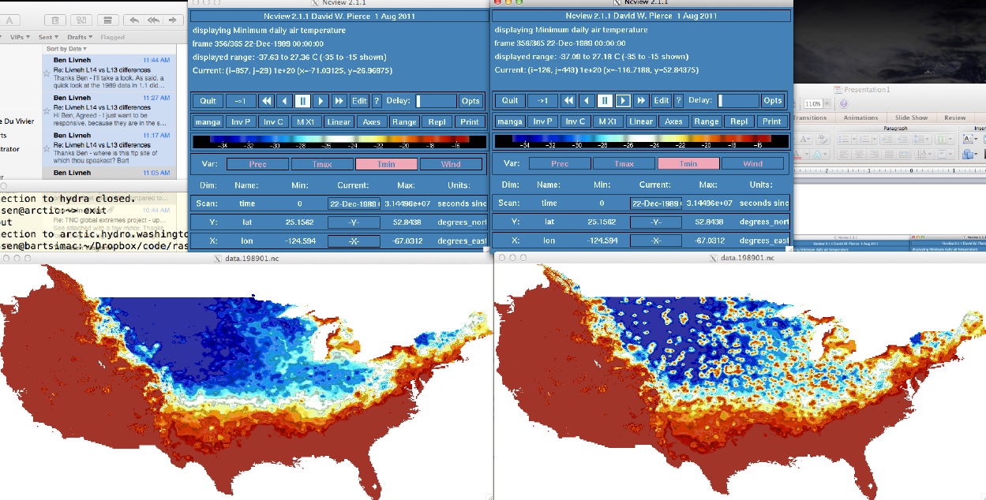
Removal of minimum temperature ‘bullseye’ pattern
Below is Bart’s screenshot of Tmin on 22 Dec 1989, showing the 0 deg. F temperature cutoff problem in forcing v.1.1 (right) versus v.1.0 (left);
The next slide shows that this is now fixed in v.1.2
Dec 22, 1989 Version 1.0
Dec 22, 1989 Version 1.1
Problem

Slide 31
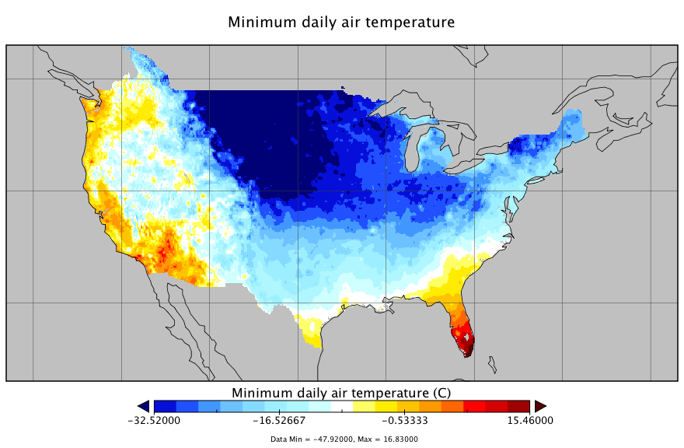
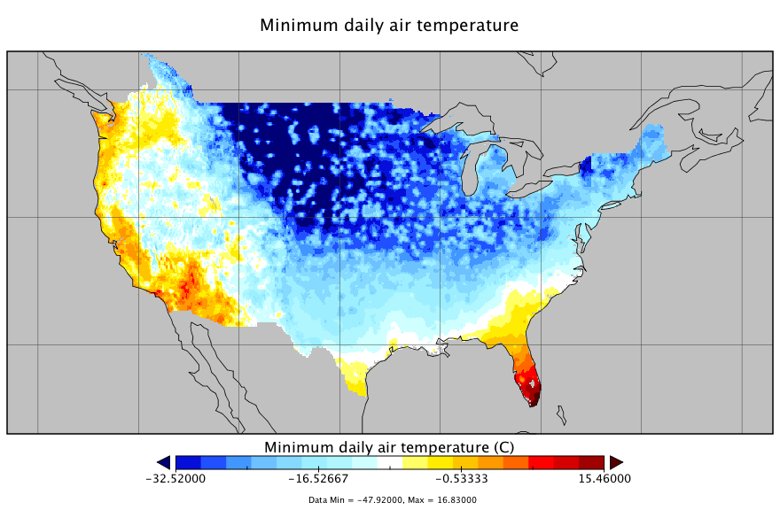
Removal of minimum temperature ‘bullseye’ pattern
Temperatures below 0 F (~-18 C) were cutoff at 0 F in v.1.1 (right);
Temperatures in v.1.2 (left) are corrected and fall below 0 F (i.e. -18 C)
Dec 22, 1989: Version 1.2
Dec 22, 1989 Version 1.1
Problem

